Slide 1
CrowdSourcing
and Smartphones
Group-4

Slide 2

INTRODUCTION
Crowdsourcing is a distributed
problem-solving model in which a
crowd of undefined size is engaged
to solve a complex problem.

Slide 3

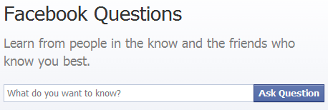
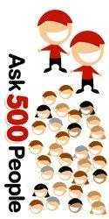


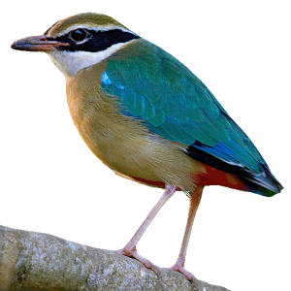

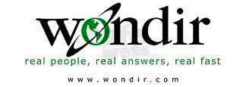
PAKSHI

Slide 4
Classification I
Web applications- participatory
Targeted applications- transparent
Ear-Phone
NoiseTube
PotHole
Explorer ,SignalGuru, Airplace, VTrack, Waze…..
3. Hybrid- both
pakshi..

Slide 5
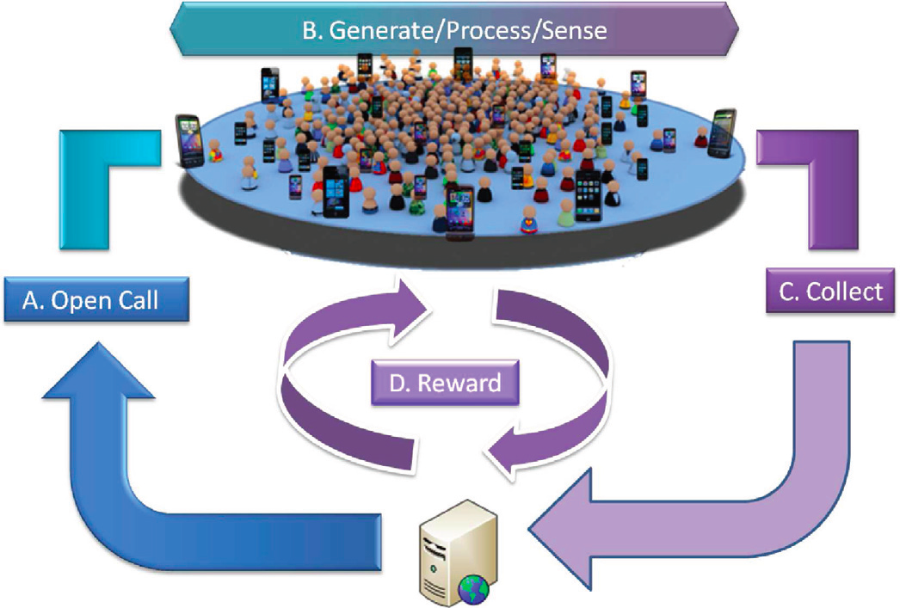
Classification II
1.Homogenous
2.Heterogenous

Slide 6
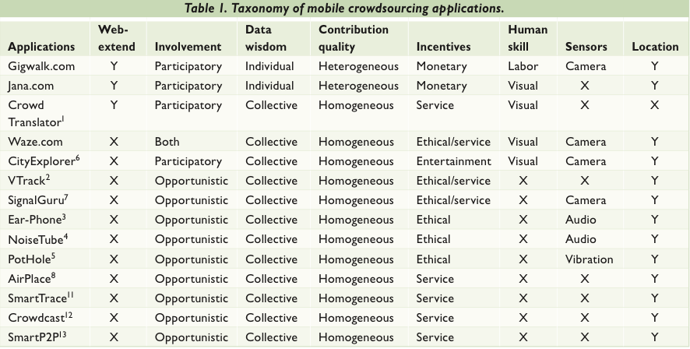
image source - [1]

Slide 7
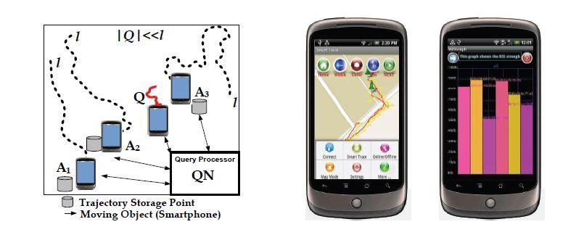
SmartTrace

Slide 8
SmartTrace
The SmartTrace project enables trace similarity search among smartphone users
It answers queries of the form “Report the users that move similar to Q”, where Q is some query trace
It optimizes such queries with respect to response time and energy consumption on the smartphones, without sharing the personal trajectories with the query processor

Slide 9
SmartTrace
Example: Consider a transit authority that plans its bus routes and wants to know whether a specific route is taken by at least k users between 7:00 - 8:00 am
SmartTrace is privacy-aware since it does not share the user trajectories to the authority, rather it only returns matching scores
More applications of SmartTrace: large-scale urban and transit planning, transit rider information,shared ride applications and social networking applications on smartphones

Slide 10
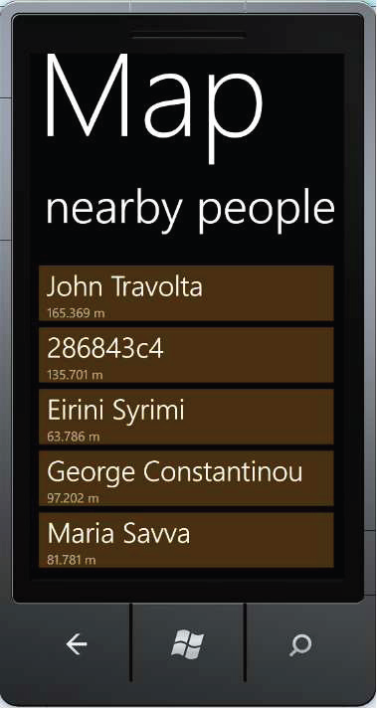
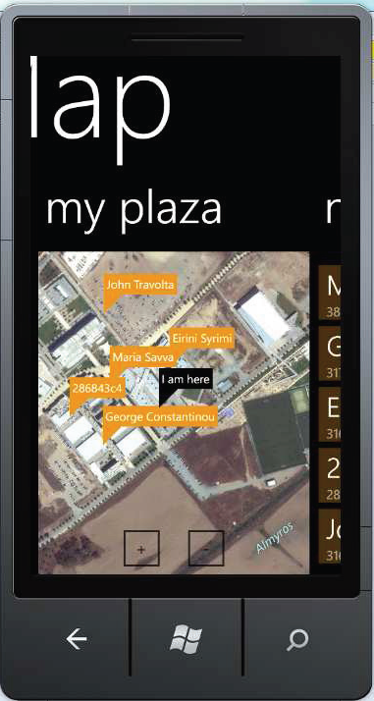
CROWDCAST
Crowdcast efficiently connects you to your closest neighbors at all times, regardless of where you are and how far they are
Neighbors can be shown in a list or on a map

Slide 11
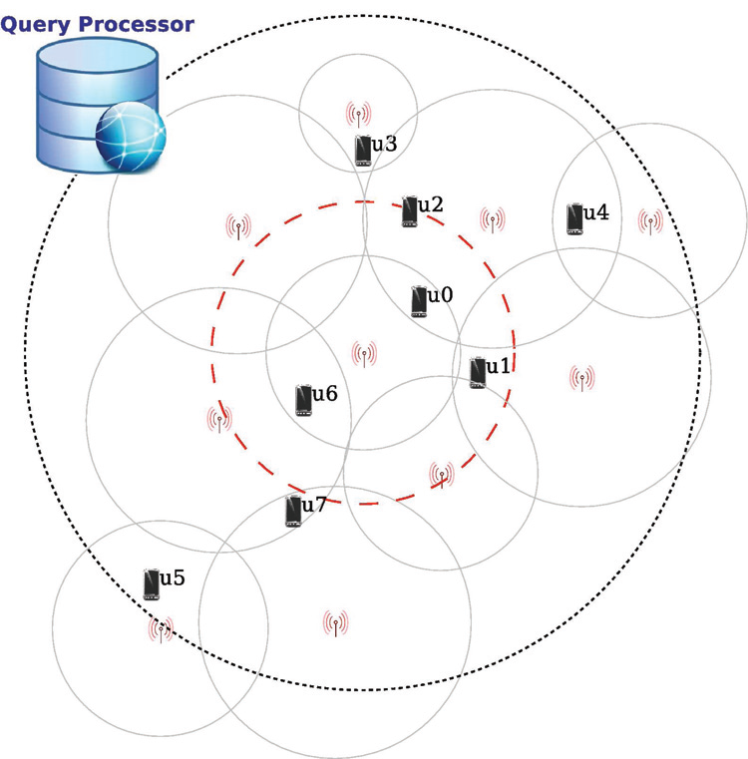
CROWDCAST
The search space of the cell is the big circle with the dotted outline
Any user inside this circle is a kNN candidate for any user inside the cell
The two nearest neighbors for u0 are {u1, u2}. Similarly for the other users: u1 → {u0, u2},u2 → {u3, u0}, u3 → {u2, u0}, u4 → {u2, u3}, u6 → {u0, u1}

Slide 12
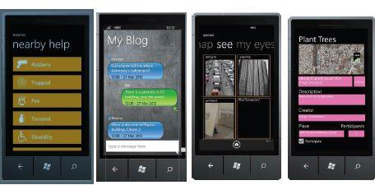
CROWDCAST
Helpcast to send out SOS beacons or disseminate natural disaster warnings
Msgcast to post local micro-blogging messages
Eyecast to extend the view on the urban environment using the cameras of one’s neighbors,
Miccast to post local vocal messages and warnings,
Taskcast to post local tasks in your neighborhood as part of local crowdsourcing or organizing a charity event, etc.

Slide 13
SMARTP2P
Smart P2P is a novel framework for searching objects (e.g. images, videos, etc.,) captured by the users in a mobile social community.
The main contribution of SmartP2P is to use location data made available by the crowd to optimize the search process.
SmartP2P can be used as a recommender system where the mobile social crowd generates instant information for certain places.

Slide 14
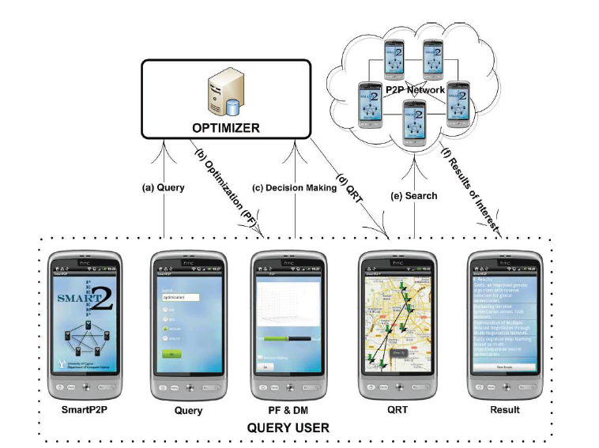
Framework Workflow and screenshots of the SMARTP2P Client Side GUI in Android
A user enters a keyword of interest to issue a query, which is subsequently optimized.
The answer is returned back to the user in a graphical format.
In the Decision Making process, the user studies all possible options and set its optimization preference with respect to recall and query execution time using a slide-bar.
The smartphone software fetches the selected optimized tree from a server and displays it along with respective annotations on a Google Maps interface.
Finally, the user searches the peer-to-peer network and obtains a list of the results of interest.

Slide 15
SMARTLAB
SmartLab is a first-of-a-kind open cloud of smartphones that enables a new line of systems-oriented mobile computing research.
SmartLab is an innovative programming cloud of approximately 40+ real Android smartphones, plus numerous emulated devices, deployed at the Department of Computer Science building at the University of Cyprus.
SmartLab provides a diverse, high-availability platform that can be utilized by the mobile computing research community to engage more effectively in systems-oriented research on smartphones.

Slide 16
SMARTLAB
Registered users can upload and install Android executables (APKs) on a number of Android smartphones, capture their output, reboot the devices, issue commands and many other exciting features.
SmartLab supports four modes of user interaction with the remote devices:
Remote Control Terminals (RCT)
Remote Shells (RS)
Remote Scripting Environment (RSE),
Remote Debug Tools(RDT)

Slide 17
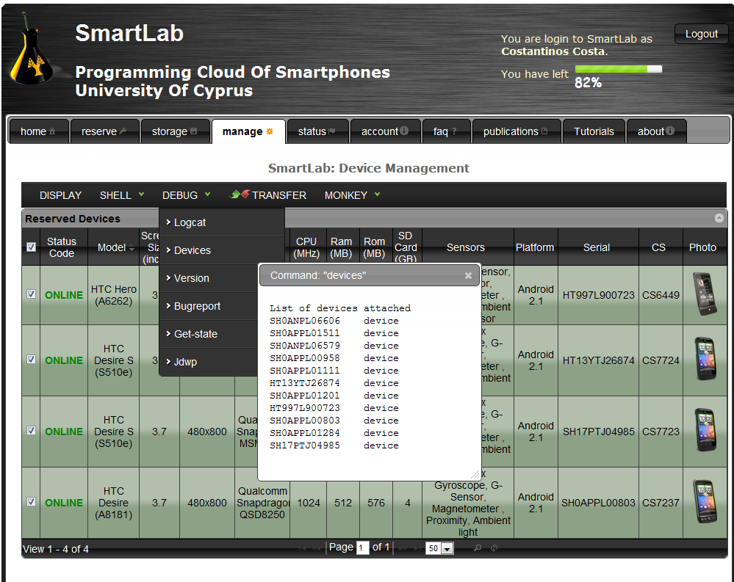
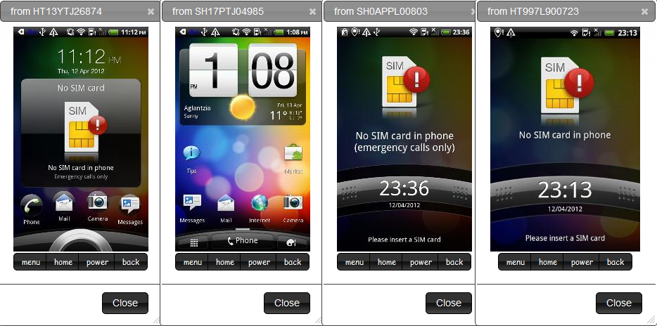
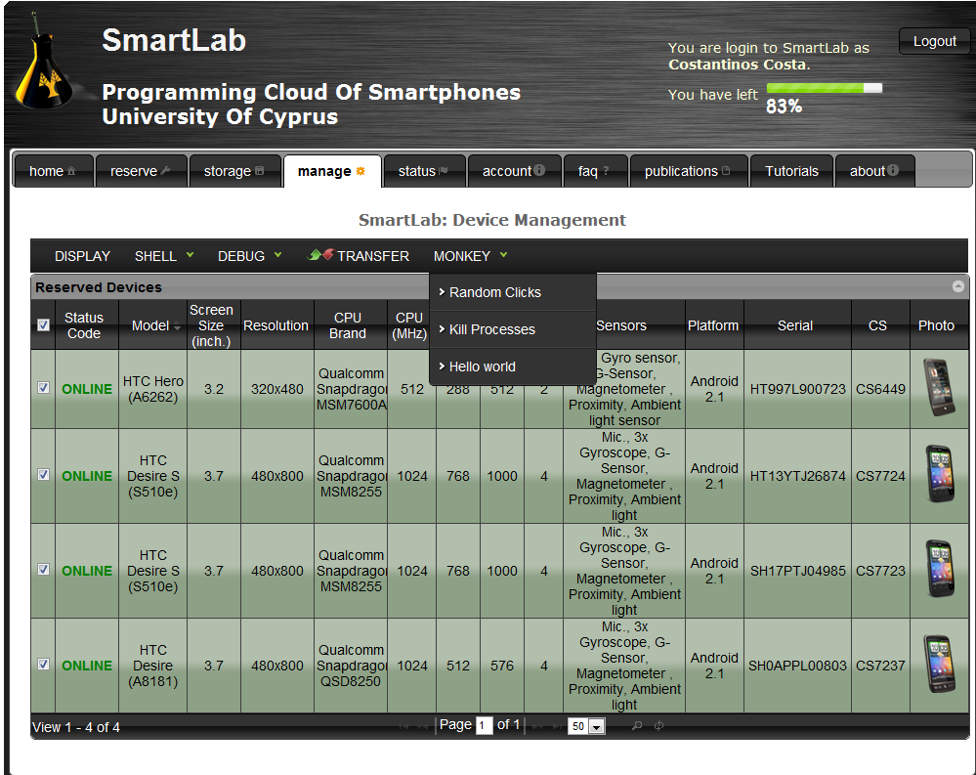
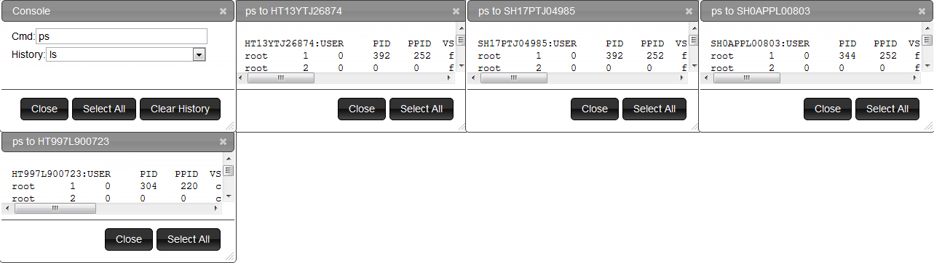

Slide 18
REFERENCE
Crowdsourcing with Smartphones - Georgios Chatzimilioudis et al, University of Cyprus
Crowdsourced trajectory similarity with smartphones
- D. Zeinalipour-Yazti
IEEE Transactions- TKDE’12
THANK YOU

